Slide 1
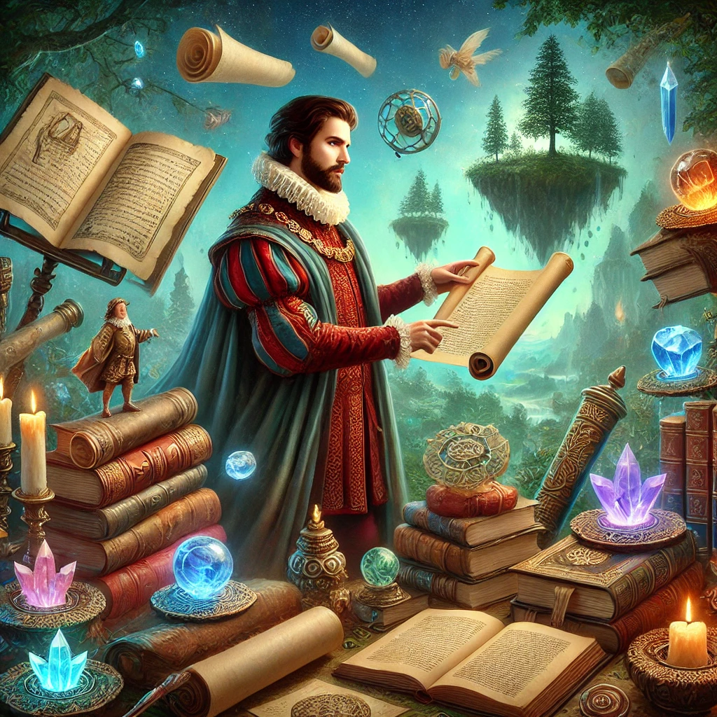
Artifacts

Slide 2
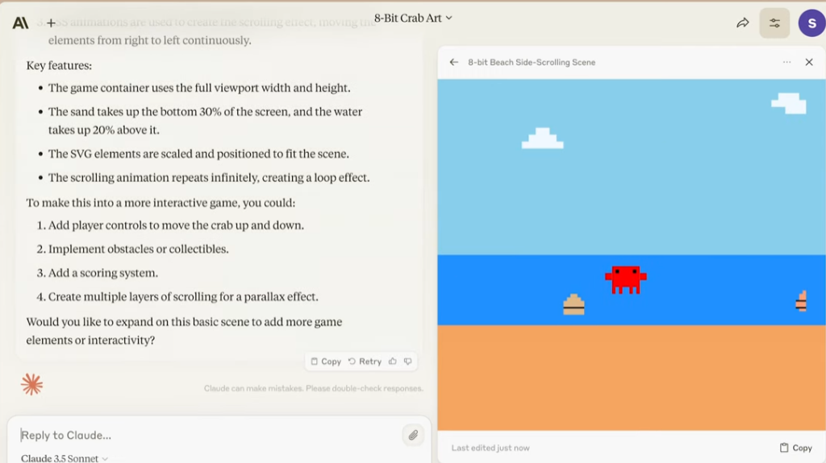
Intro Video
Notes:
https://www.youtube.com/watch?v=rHqk0ZGb6qo

Slide 3
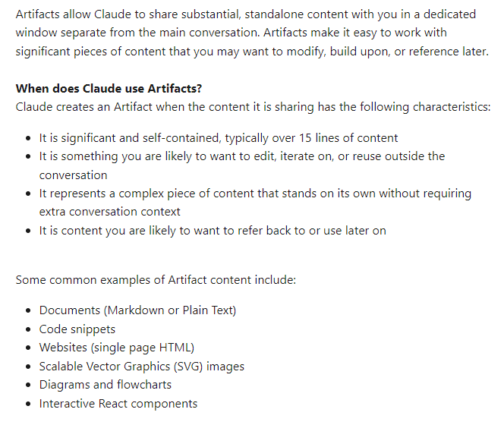
artifacts
Notes:
https://support.anthropic.com/en/articles/9487310-what-are-artifacts-and-how-do-i-use-them

Slide 4
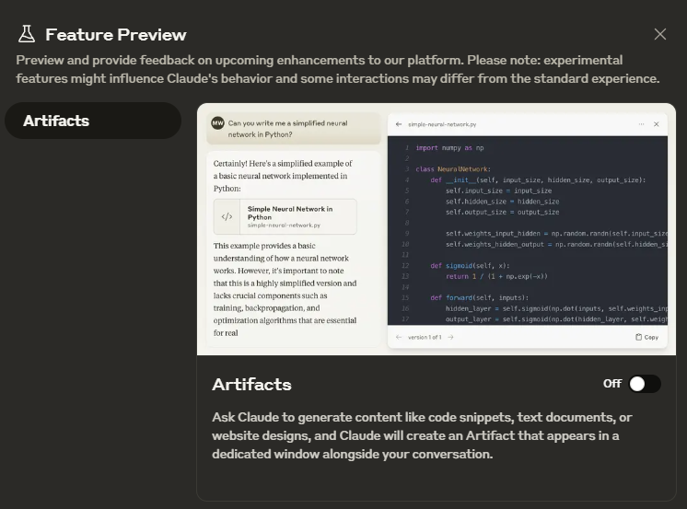
Artifacts
Notes:
Can you put that into a formatted text document?
Can you put this into a well formatted Microsoft word document?
Create a flowchart of the typical penguin lifecycle
Create a code snippet that is a function that prints any name given to it 10 times
Put it in my artifacts
Create a simple SVG image for me
Create a single web page that takes in a name and returns it to a label once you press a button
Create a webpage that connects to any public api and pulls back data
Create a simple interactive React webpage
Create a complex interactive React webpage

Slide 5
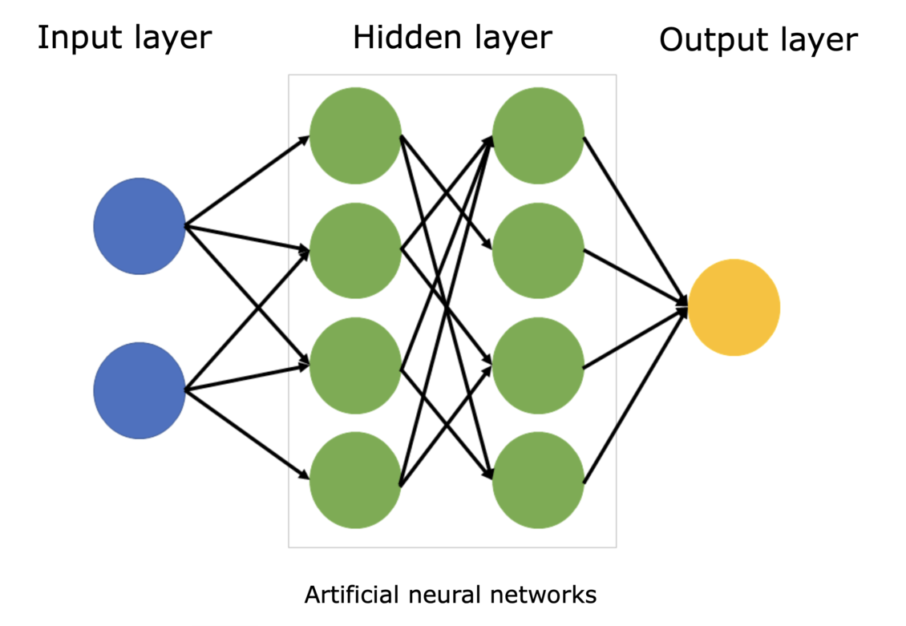
Advanced Artifact Usage: Animations
Notes:
Can you turn this into a simple react animation so I can understand it better
Give it much more detail and layers so I know what is going on at each phase and indicate any types of calculations that could happen

Slide 6
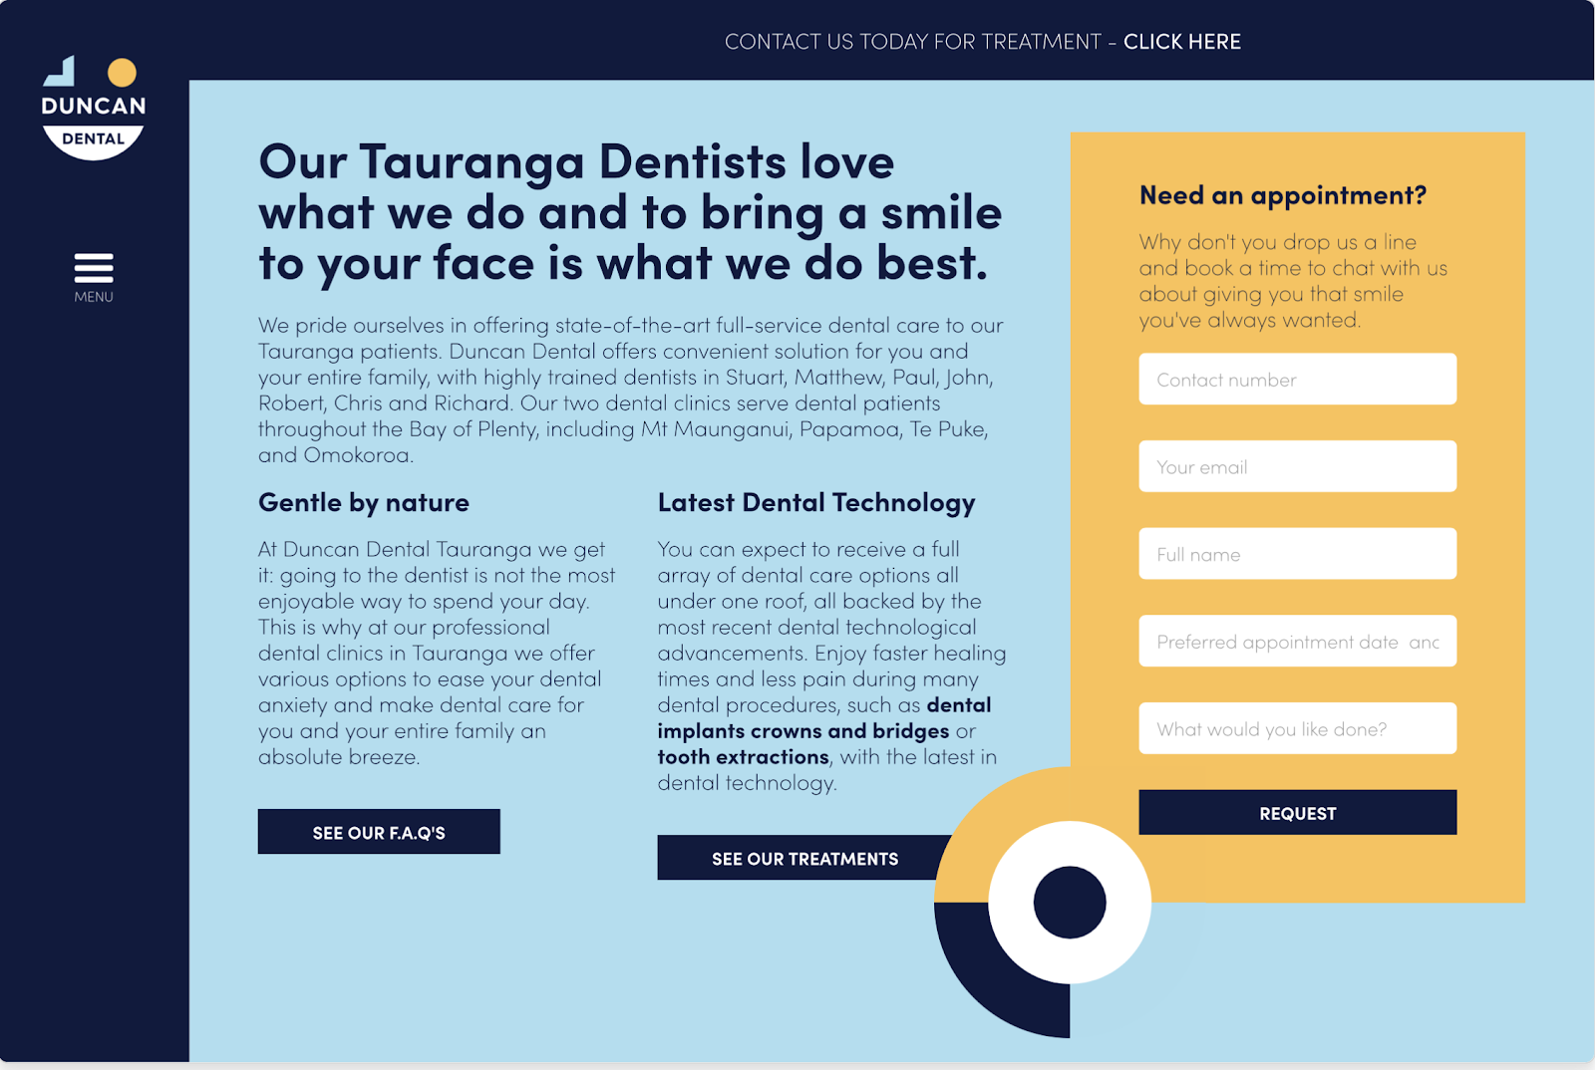
Advanced Artifact Usage: UX Design
Notes:
https://webflow.com/blog/ux-design-examples
Can you recreate this in react for my company called "Dental King"?
Can you make it look more like the picture I gave you?

Slide 7
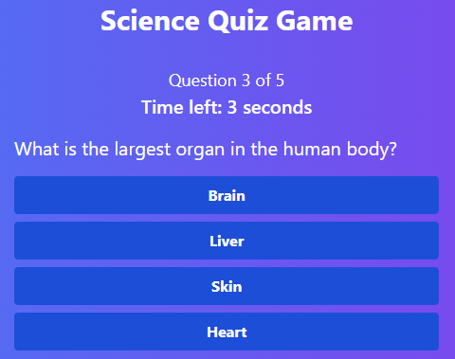
Advanced Artifact Usage: Games
Notes:
Can you create a game for me to play? I'm bored and I love science.

Slide 8
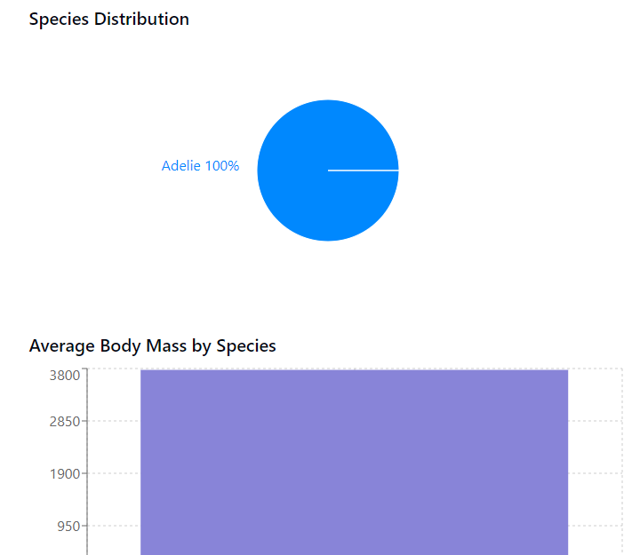
Advanced Artifact Usage: Data Visualization
Notes:
Can you turn this data into JSON and then use it in a react page to visualize the data in a variety of ways?
Use only basic components that don't need an install
Only use components that you support in artifacts

Slide 9
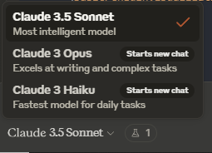
Changing Models

